Slide 1
Capstone Project
Trauma and Coping Skills
Paul Trimble 01-14-2022

Slide 2
Source and Problem Statement
Source: study of 108 university students, with various levels of reported trauma experience scores, as well as measurement of various trauma coping skills and strategies
Target variable selected=current trauma symptoms experienced
Trauma coping variables: Cognitive Flexibility, Flexibility of Emotional Expression, and Flexible Use of Coping Strategies
Age, Gender, Marital Status, and Education data also collected

Slide 3
Source and Problem Statement
Problem Statement: From this data, can it be shown that trauma coping strategies cause, or at least are associated with, lower trauma symptoms scores?
If so, can equipping people with improved coping skills and strategies mitigate trauma symptoms and experiences
Demographic variables to be included in the data as well, since the model sought after would be an explanatory model (for understanding purposes) rather than a predictive model

Slide 4
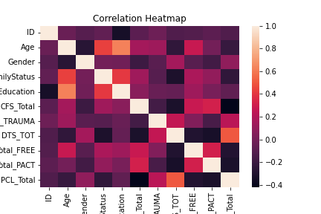
Exploratory Data Analysis
Cursory analysis of variables shows coping skills variables have weak correlations, trauma measure variables also have weak correlations
But can coping skills be used to model or explain trauma symptoms?

Slide 5
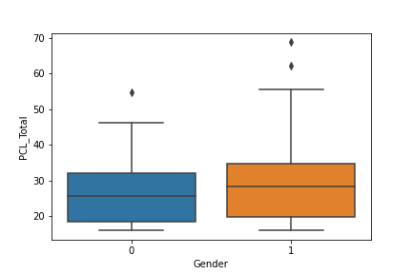
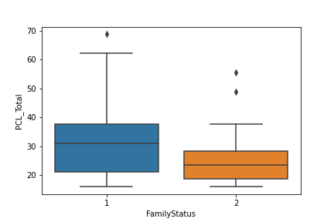
Exploratory Data Analysis
Demographic variables may hold some value
Gender and Family Status (married vs single) show moderate differences
Are the differences statistically significant?

Slide 6
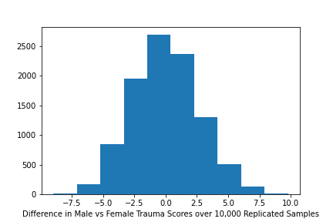
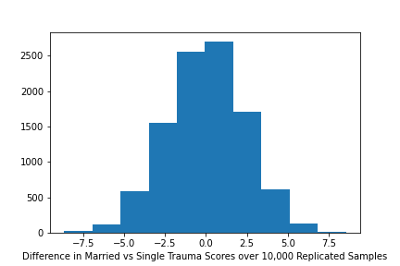
Exploratory Data Analysis
Male vs Female difference=6 points
Married vs Single difference=2.5 points
Scrambling the trauma scores among the subjects 10,000 times yields the differences shown
Male/Female is not significant, Married status is statistically significant

Slide 7
Exploratory Data Analysis
Retain age and marital status in the model
Drop education and gender from the model

Slide 8
Modeling
We fitted a linear regression model
In addition, two variations of linear regression: Ridge and Lasso
Ridge and Lasso are similar to linear regression but better for modeling data where the variables are correlated with each other
Ridge and Lasso methods both require scaling the data: making sure the features are of similar magnitude to better assess relative contribution to the trauma score

Slide 9
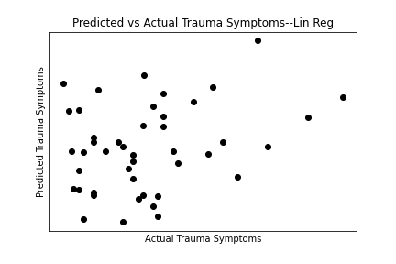
Modeling
Results of linear regression very weak
Shown is results of plotting model predicted trauma scores against actual trauma scores
Wide scatter shows inability to predict trauma scores from our variables
Training r^2=.037; Testing r^&2=.015

Slide 10
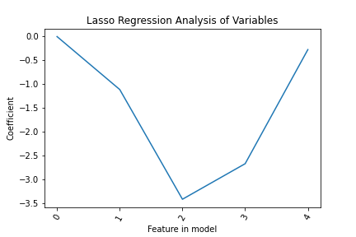
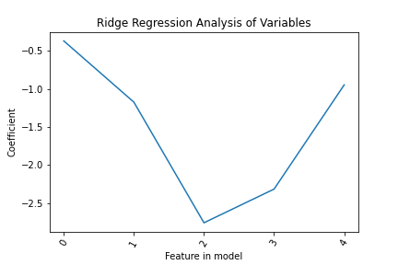
Modeling
Ridge and Lasso don’t perform much better
Shown are the results of feature analysis of each
Larger difference from 0 means more influential in model
Cognitive flexibility (2) and flexible emotional expression (3) rank highest
Model scoring reflect low model performance

Slide 11
Modeling Evaluation
Model | Training Score | Testing Score | Cross Validating Score | Hyperparameter selected (alpha)
Linear Regression | 0.375 | 0.015 | 0.109 | N/A
Lasso Regression | 0.367 | 0.006 | 0.243 | 0.616
Ridge Regression | 0.361 | 0.039 | 0.241 | 23.43
Overall underwhelming results
Ridge regression would be preferred model based on theory and testing performance
Testing score of .039 and cross validation score of .243 are evidence of mild explanatory value
Experiments with control groups and coping skills treatments might yield better results

